Slide 1
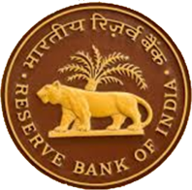
भारतीय रिजर्व बैंक
Reserve Bank of India
Career with RBI

Slide 2
About Us
The Reserve Bank of India was established on April 1, 1935 in accordance with the provisions of the Reserve Bank of India Act, 1934.
The Central Office of the Reserve Bank was initially established at Calcutta but was permanently moved to Mumbai in 1937. We have 32 offices including a sub-office located across the nation.
We are a full-service Central Bank handling a variety of functions. For more information, please go through the information brochure.

Slide 3



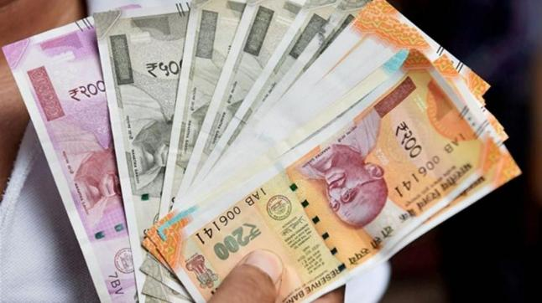

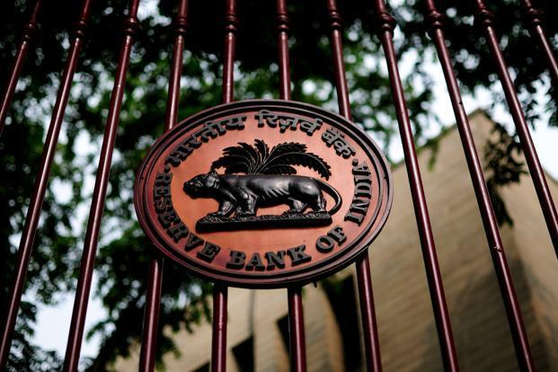

RBI does much more than you thought !
Supervisor of the Financial System
Monetary Authority
Developmental & Regulatory Role
Currency Management
Overseeing Payments & Settlements Systems
Banker to the Government & Banks
Foreign Exchange Management

Slide 4
Major Milestones….
Notes:
Move the 1998, 1997 to next slide

Slide 5
Major Milestones….
Notes:
Move the 2016, 2018 and 2019 to next page/slide

Slide 6
Major Milestones….
2018
Establishing of Economic Capital Framework for RBI
2020-21
Deployment of unconventional monetary policy tools during the COVID-19 pandemic
2016
Introduction of Flexible Inflation Targeting and establishing of MPC &
Launch of Unified Payment Interface
2019
RBI introduces Ombudsman scheme for digital transactions
2021
Launch of Integrated Ombudsman Scheme

Slide 7
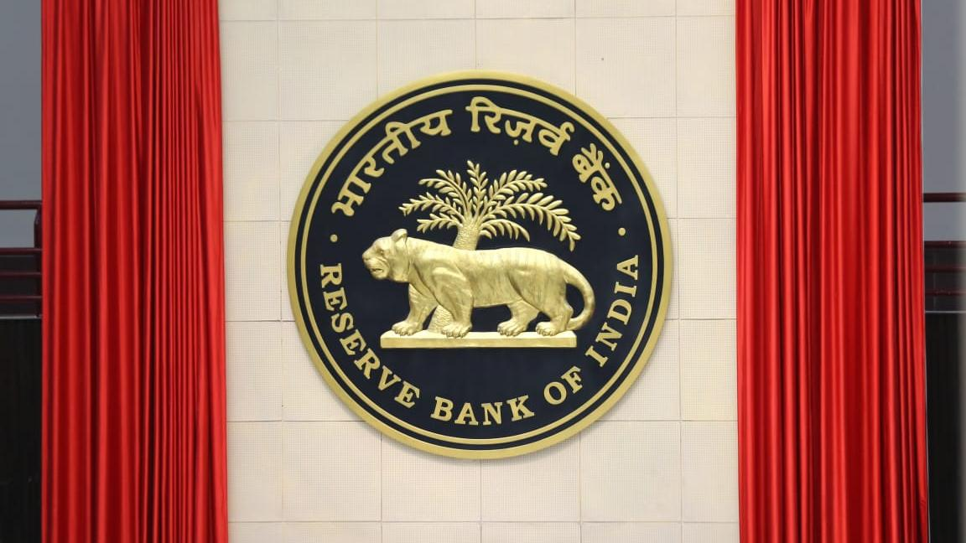
Opportunities at RBI- A Career in Finance and Public Policy
Life with RBI is not just another job.
It’s a commitment. Commitment to serve the nation, where your decisions make an impact on the way the economy and the financial sector in the country evolves.

Slide 8
What to expect in a career at RBI?
Team up with the best minds
Spearhead reforms
Touch the lives of millions
Do research that matters
Join the global mainstream

Slide 9





Highlights of work at RBI
Intellectual Fulfillment
Stability
Skill Enhancement
Social Esteem
Think Together
Belongingness
Equal Opportunity Employer
Make a Difference
Supportive HR Climate
RBI
Rewarding Career
Attractive Compensation

Slide 10
Perquisites & Benefits
In addition to the monthly emoluments, the Bank offers various perquisites and benefits* such as :
Provision of accommodation by Bank (subject to availability)
Reimbursement of various expenses such as for maintenance of vehicle for official purpose, purchase of journals/books/newspaper, etc.
Medical Benefits including a free dispensary facility and reimbursement of medical expenses for OPD treatment/hospitalization
Leave Fare Concession, Loans and Advances at concessional rates of interest for Purchase of residential property, Vehicle, Consumer Articles, Education of wards, etc.
* subject to eligibility and extant terms & conditions

Slide 11
Work Culture
RBI emphasizes on an accommodative work culture and boasts of a bouquet of employee friendly policies including those designed especially for lady employees.
Women-Centric Policies
Maternity benefits
Special hardship leave
Flexi-work hours
Office pick-up and drop facility (for odd working hours)

Slide 12
Our Presence
The RBI has 32 Offices and sub-offices - most of them in state capitals. Its Central Office is in Mumbai. It has four training establishments - two in Mumbai (RBI Academy and College of Supervisors), one each in Chennai (Reserve Bank Staff College) and Pune (College of Agriculture and Banking). In addition, it also has four Zonal Training Centres, one each in Mumbai, New Delhi, Kolkata and Chennai.
During your career, you will get a chance to work in different departments and centers.

Slide 13
Grade ‘B’ -DR-General Stream Selection Process
a) Phase I - Objective Type MCQ Test with 4 modules viz. General Awareness, Quantitative Aptitude, Reasoning, English Language
b) Phase II – Mixed Pattern - Paper I Economic & Social Issues
Paper II English Descriptive
Paper III Finance & Management
c) Interview
Note: We also have recruitment in specialised streams such as legal, Rajbhasha, etc. For details, please visit our website https://rbi.org.in

Slide 14
How to apply?
Candidates are advised to ensure their eligibility for the posts before applying.
Candidates are required to apply ONLINE only through the Bank's website https://rbi.org.in
Visit the URL “Recruitment for the post of “Officers in Gr.’B’ (DR) General/DEPR/DSIM” on Bank's website i.e. www.rbi.org.in >Opportunities@RBI >Current Vacancies > Vacancies and click on the hyperlink “Online Application Form” provided in the notification.
Candidates will have to enter their details and upload the photograph, signature, left thumb impression and a hand-written declaration in the online application form as per the specifications given.

Slide 15
Thank you!

