Slide 1
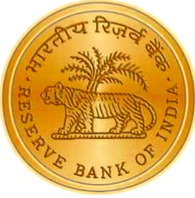
18th SAARC Payment Council Meeting
RESERVE BANK OF INDIA

Slide 2
Contents
Major Development since last Meeting
Financial Market Infrastructure
Retail Payments
Some Products in Retail Payments
Vision 2015-2018
Growth in Payment Systems
2

Slide 3
Major Development since last Meeting
Financial Market Infrastructure (1/2)
CCIL has been designated as Trade Repository under PSS Act 2007
ESMA identifies CCIL as a recognised CCP as India has equivalent regulatory regim under EMIR
Under FSAP, CCIL a CCP in India is found compliant of 21 PFMI principles
RBI Mandates LEI for participants of OTC derivatives market and also to large corporate borrowers with fund base / not-fund based exposure (₹ 50 million and above)
3
Notes:
ESMA – European Securities and Markets Authority
EMIR – European Market Infrastructure Regulation

Slide 4
Major Development since last Meeting
Financial Market Infrastructure (2/2)
Real Time Gross Settlement System
Rationalisation of Charges
Implementation of Mixed MNSB (without LOC)
Positive Confirmation
Hardware upgrade Z196 to Z14
4

Slide 5
Major Development since last Meeting
Retail Payments
Introduced half hourly settlements in NEFT
Rationalisation of Merchant Discount Rate for various categories of merchants.
Comprehensive Review of PPI guidelines with major focus on KYC guidelines, type of PPI, customer service and protection, complaint redressed mechanism, non-forfeiture of unutilised balance, security /safety and Interoperability
Interoperable cash deposit under NFS network.
5

Slide 6
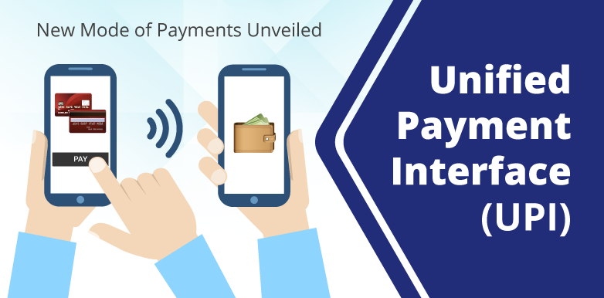
Major Development since last Meeting
Some Products in Retail Payments (1/5) UPI
A fast Payment System – Users can send/ receive money upto ₹ 100 thousand.
Uses an identifier called VPA (Virtual Payment Address)
Enables interoperability among mobile banking apps of different banks
Facilitates Merchant Pull payments
Multiple bank model for large third party players – Google Tez and Whatsapp
6

Slide 7
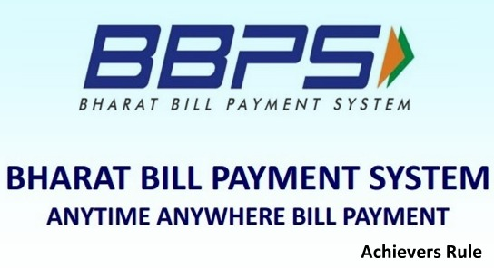
Major Development since last Meeting
Some Products in Retail Payments (2/5) BBPS
It is an integrated Bill Payment System – offers “anytime anywhere bill payment service.
BBPS provides multiple payment modes and instant confirmation of payments.
BBPS framework consists of two types of entities – (i) BBPCU and (ii) BBPOUs
Multifold benefits such as – enable billers to save cost, facilitates standardisation of electronic platform, bill fetch facility.
7

Slide 8
Major Development since last Meeting
Some Products in Retail Payments (3/5) Bharat QR
A QR based payment solution, initiating and accepting payments between buyers and sellers (or consumers and merchants) using the mobile phone
QR code transaction can be done using RuPay Debit , RuPay Credit or pre-paid card.
It is a person to merchant mobile payment solution.
User can scan these QR via BQR enabled mobile banking app and pay using Card linked account VPA / IFSC + Account / Aadhaar
8

Slide 9
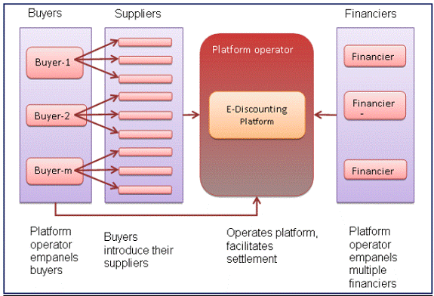
Major Development since last Meeting
Some Products in Retail Payments (4/5) TReDS
The scheme for setting up and operating the institutional mechanism for facilitating the financing of trade receivables of MSMEs from corporate and other buyers, through multiple financiers is known as Trade Receivables Discounting System (TReDS).
9

Slide 10
Major Development since last Meeting
Some Products in Retail Payments (5/5) TReDS
It facilitate the discounting of both invoices as well as bills of exchange.
The transactions processed under TReDS will be “without recourse” to the MSMEs.
TReDS provide the platform to bring participants together for facilitating uploading, accepting, discounting, trading and settlement of the invoices / bills of MSME
MSME sellers, corporate and other buyers, including the Government Departments and PSUs, and financiers are the direct participants in the TReDS
10

Slide 11
Payment System Vision Document 2018 (1/2)
Building best of class payment and settlement systems for a ‘less-cash’ India through responsive regulation, robust infrastructure, effective supervision and customer centricity
Principles
Coverage
Convenience
Confidence
Convergence
Cost
11
Notes:
Payment System Vision 2018 revolves around 5 Cs:
Coverage – by enabling wider access to a variety of electronic payment services
Convenience – by enhancing user experience through ease of use and of products and processes
Confidence – by promoting integrity of systems, security of operations and customer protection
Convergence – by ensuring interoperability across service providers
Cost – by making services cost effective for users as well as service providers

Slide 12
Payment System Vision Document 2018 (2/2)
Key Drivers
Key Enablers
Government Push
Internet Penetration
Aadhaar Penetration
Financial Inclusion
Move to a ‘Less Cash’ economy
Latent customer demand for faster payments
Integration of government payments
Interoperability
12
12
Notes:
Customer Centricity is one of the strategic initiative of Vision 2018, includes customer education/ awareness and strong grievance redressal mechanism.
Move from cash intensive society to less cash society.
Improving Accessibility and interoperability.
Making payment easy using biometrics.
Facilitate government initiatives through electronic platform.

Slide 13
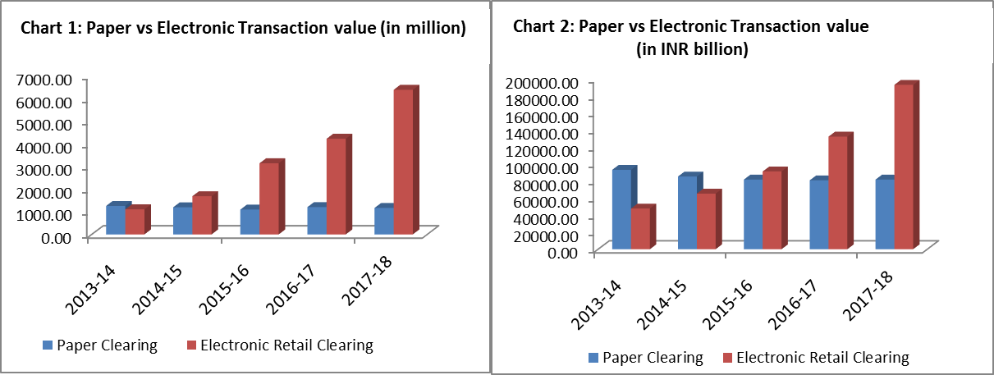
Growth in Payment Systems (1/5)
Paper Vs Electronic Transactions
During 2017-18, while in volume terms, the share was 7.37 per cent of the total transactions (down from 10.98 per cent the previous year), its share in value terms declined to 3.24 per cent (from 3.58 per cent). Though in value terms, there was a decline, the rate of decline was lower in FY 2017-18 vis-à-vis the previous year.
13
13

Slide 14
Growth in Payment Systems (2/5)
Trends in RTGS
The RTGS volume and value registered a y-o-y growth of 16% and 23% in Jun 18. However, RTGS volume declined by a percentage point in Jun 18 over May 18 mainly due to decline in interbank transactions, but value registered a growth of 8% during the same period. The average value per transaction (AVPT) was approximately Rs 9.99 million during Jun 18(Chart 1). AVPT was Rs. 9.44 million and Rs. 9.50 million in Jun 17 and Jun 16 respectively.
14
14

Slide 15
Growth in Payment Systems (3/5)
Trends in NEFT
NEFT volume and value registered a growth of 16% and 50% respectively in Jun 18 over Jun 17 Chart 2). Similarly, NEFT volume and value registered a growth of 2% and 11% in Jun 18 over May 18 respectively. The average value per transaction was approximately Rs 1,07,348 during Jun 18, which was higher than May 18 (it was Rs 99,193)
15
15

Slide 16
Growth in Payment Systems (4/5)
Trends in Card Payments
The Volume and value of PPI transactions increased by 8% and 16% in May 18 over Apr 18. Also, y-o-y growth in volume and value of PPI transactions was 26% and 46% in May 18 (Chart 4). PPIs volume and value grew by 26% and 46% in May 18 over May 17. The volume and value of Cards at POS transactions have been steadily growing since Feb 2018. The y-o-y growth for volume and value of Cards at POS was 30% and 28% respectively in May 18. The average value per transaction was Rs. 1,920 in May 18 (Chart 4). Though the volume of debit cards at POS are almost double than the volume of credit cards at POS, both are moving together in terms of value (Chart 5).
16
16

Slide 17
Growth in Payment Systems (5/5)
Ticket Size of Payments
In terms of fast payment systems the average value per transaction (AVPT) was higher for IMPS and it was Rs. 9,380 in Jun 18 (Chart 6). AVPT was Rs. 9,060 a year ago.
17
17

