Slide 1

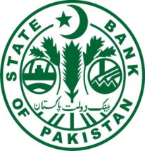
SAARC PAYMENT COUNCIL
Country Presentation
Pakistan
Syed Sohail Javaad
(Director)
Payment Systems Department
State Bank of Pakistan

Slide 2





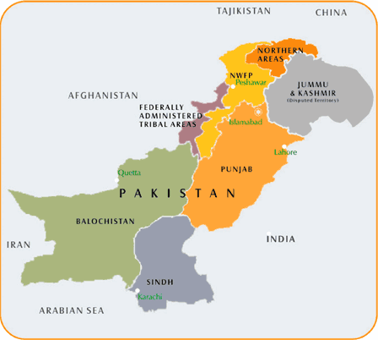
Pakistan - Demographics
Surface Area: 796,095 Sq. km
Population: 207.77 million
Financial Inclusion: 23% (2015)
GDP (FY 17): USD 300 billion
Per Capita Income: USD 1,690
Currency in Circulation: PKR 4.6 trillion
Total Labor Force: 61 million
Literacy rate: 58%
Urban Population: 35%
Rural Population: 65%
Cellular Subscribers: 150 million
3G/4G Subscribers: 56 million
Broadband Subscribers: 58 million
No of Bank Accounts: 51 million

Slide 3
Major Payment System Players in Pakistan
State Bank of Pakistan
Banking System
PSOs /PSPs/ TPSPs*
Other Players
Banks
1Link
Branchless Banking
Telco / Telco-agnostic
Micro-finance
Banks
NIFT
Payment Schemes
International / Domestic
Development Finance Inst.
VRG
NCCPL
Capital Markets
Exchange Companies
NADRA
Citizenship & Digital ID
*Payment System Operators; Payment System Service Providers; Third Party Service Providers

Slide 4
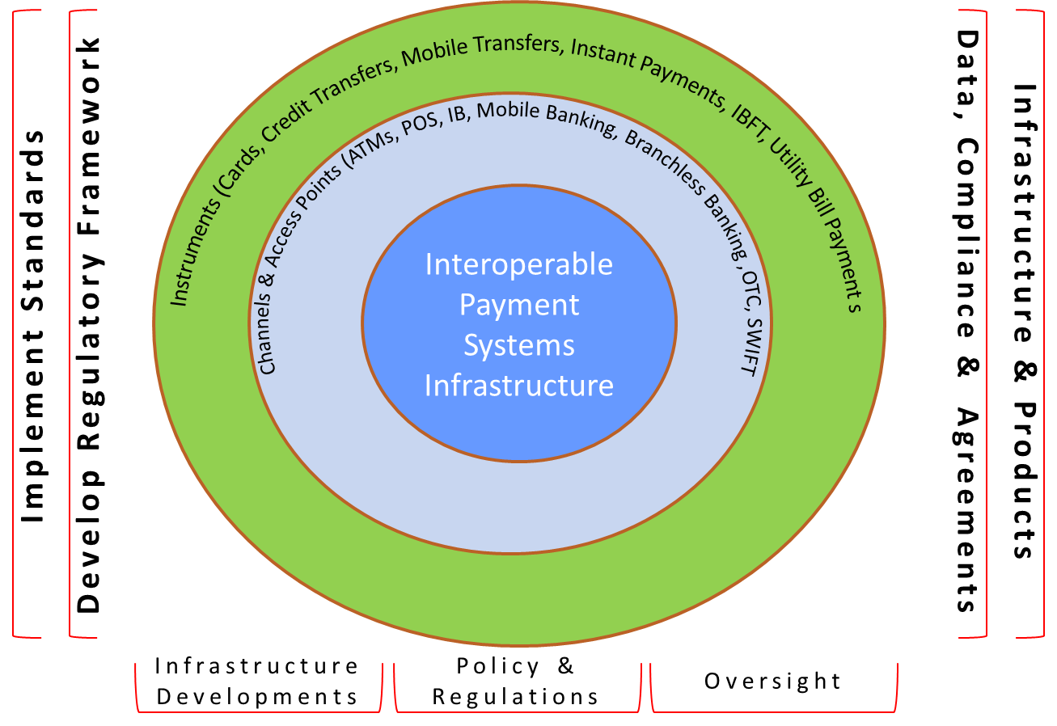
Payment Eco-system in Pakistan

Slide 5
Payment Instruments & Schemes in Pakistan
Paper Based Instruments
  Cheques
  Demand Drafts/ Pay Orders(Banker’s Cheques )
Electronic
International Cards Schemes
  VISA
  MasterCard
  Union Pay International (previously CUP)
  Amex
Domestic Cards Scheme
  PayPak
PRISM (RTGS) (Large-Value Payment System)
Online Branches, ATMs, Internet Banking, Mobile Phone Banking and Call Centers/ IVR Banking
Services, Inter Banks Funds Transfers, Utilities Bills Payments, Mobile Top Ups etc.
eCommerce – Registered Merchants with Banks

Slide 6

Key Payment System Players in Pakistan
Pakistan Real-time Interbank Settlement Mechanism (PRISM)
The PRISM (Real Time Gross Settlement System) of Pakistan comprises of Fund Transfers and Securities Settlement Systems
    Interbank Fund Transfer
    Government Securities Settlement
    Settlement of the clearing of Ancillary payments
    Customers’ Fund Transfer
    Collection of Government Tax receipts (FBR collections)
    Inland delivery of home remittance
The PRISM system has Straight Through Processing with the Core Banking Systems of participant banks

Slide 7
Key Payment System Players in Pakistan
National Institutional Facilitation Technologies (NIFT)
A semi-automated Clearing house, NIFT is responsible for:
  Clearing of all paper-based payment instruments in Pakistan
  It has offices across the country
  It processes cheques based on MICR using automated sorters
  Prepare and submit Clearing Batches to RTGS for Settlement purpose i.e. same day, normal, intercity etc.

Slide 8
Key Payment System Players in Pakistan
1-Link
Owned by a consortium of 11 Commercial Banks
1Link is:
    An interoperable Switch for all ATMs and POS in Pakistan
    Inter-bank Fund Transfer Facility (IBFT) that enables instant inter-bank transfer of funds at retail level
    Online facility for collection of Taxes and duties
    Online Utility Bill Payments (UBPS)
    ‘PayPak’ Payment Scheme – The first Domestic Payment Card Scheme in Pakistan

Slide 9
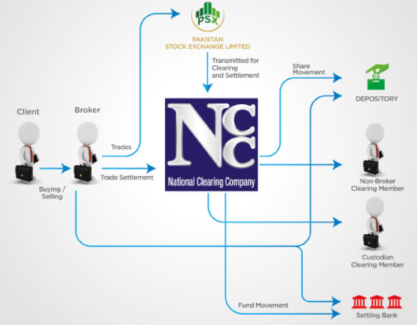
Key Payment System Players in Pakistan
National Clearing Company of Pakistan Limited (NCCPL)
Provides Clearing services to the Pakistan Stock Exchange Limited via its National Clearing & Settlement System (NCSS)
Settlements are processed in PRISM System
A special participant of PRISM System
https://www.nccpl.com.pk/en/about-us/about-nccpl/introduction

Slide 10
Payment Systems Infrastructure at a Glance
Number of Banks (and their branches) | 45(14,970)
Commercial/Specialized | 34(13,908)
Microfinance | 11(1,062)
Number of Banks having:
ATMs | 32
Point of Sale | 9
Internet Banking | 28
Mobile Phone Banking | 20
Call Center Banking | 21
Number of PRISM System Participants | 43
Number of Registered e-Commerce Merchants | 1,094
Total Number of ATMs | 14,019
Number of ATMs Interoperable Switches | 1
Number of Cash Deposits Machines (CDMs) | 52
Total Number of POS Machines | 53,511

Slide 11
Transaction trends in Payment Systems

Slide 12
SBP Vision 2020
SBP Vision 2020 has following Strategic Goals:
  Enhance the effectiveness of monetary policy
  Strengthen the financial system stability regime
  Improve the efficiency, effectiveness, and fairness of the banking system
  Increase Financial Inclusion
  Develop modern and robust payments systems
  Strengthen SBP’s organizational efficiency and effectiveness.

Slide 13
SBP Initiatives to Promote Digital Financial Services
Strengthen Legal, Regulatory and Oversight frameworks
Encourage the private sector in promoting interoperability and use of DFS
Rules for Payment Systems Operators (PSOs) and Payment System Providers (PSPs) (created conducive environment for non-banks)
Standardization of Payment messages and financial instruments
  Adoption of IBAN, EMV Compliance etc.
Safety and Security of Consumers and Payment Channels
National Payment Gateway Program
  Micro Payment Gateway for Retail Transactions
  Automated Transfer System (ATS)

Slide 14
Factors Inhibiting Digitization of Payments
Cultural & Behavioral aspects
  Cash is still the Emperor!
Reluctance to be a part of formal economy (formal documentation)
Low level of financial literacy
Low access to formal financial services
High cost of financial services
Limited role of Non-Banks in Payments
  Expected to change with the emergence of Fintechs

Slide 15
SBP Achievements in Recent Years
IBAN Implementation & Adoption
Issuance of Rules for Payment Systems Operators and Payment Service Providers
New Rules for Large-Value Payment System - PRISM
  Extension of System Participation
  Enhanced Outreach to General Public (Customers’ Transfers)
  Implementation of STP
  New Operating Rules
  Automation of Government Receipts (FBR Receipts)

Slide 16
SBP Achievements in Recent Years…Cont.
Payment Systems Designation Framework
Issuance of Regulations for
  Pre-Paid Cards Issuance
  Payments Card Security,
  Security of Internet Banking
  Electronic Fund Transfers (EFT)
  Guidelines for White Label ATMs
  Guidelines for Clearing Operations
  Standardization of Paper-based payment instruments
Enhancement of Payment Systems Data Reporting
Issuance of Advisory on Virtual Currency

Slide 17
Way Forward
  National payment Systems Strategy with the World Bank
  Development of National Payment Gateway
  Micro Payment Gateway
  Fintechs
  Adoption of New Technologies and innovations
  Development of Digital Transaction Accounts Scheme

Slide 18



Slide 19
Payment Systems Transactions Trend

