Slide 1
Empowering women through financial education
India-OECD-World Bank Regional Conference on Financial Education
4-5 March 2013, New Delhi, India
CHIARA MONTICONE
OECD
with the support of the
Russia/World Bank/OECD Trust Fund

Slide 2
Global relevance
  “We recognize the need for women and youth to gain access to financial services and financial education, ask the GPFI, the OECD/INFE, and the World Bank to identify barriers they may face and call for a progress report to be delivered by the next Summit.”
G20 Leaders’ Declaration, Mexico, June 2012

Slide 3
Rationale for focusing on women
Both women and men need to be sufficiently financially literate. Women’s needs are even higher, because they:
Typically have fewer financial resources than men (e.g. lower labour market participation, lower earnings, discontinuous careers for caring activities...)
Live longer on average than men
→ Need to manage resources well and for longer periods to improve access to economic / financial opportunities and to avoid poverty in old age
Notes:
Both women and men need to be sufficiently financially literate to effectively participate in economic activities and to take appropriate financial decisions for themselves and their families. However, women need to improve their financial literacy even more than men because they typically tend to live longer and earn less than men, therefore being more likely to face financial hardship in old age. In addition, their level of financial knowledge tends to be lower than men’s, suggesting that they may not be up to the challenges they face in achieving their financial well-being

Slide 4
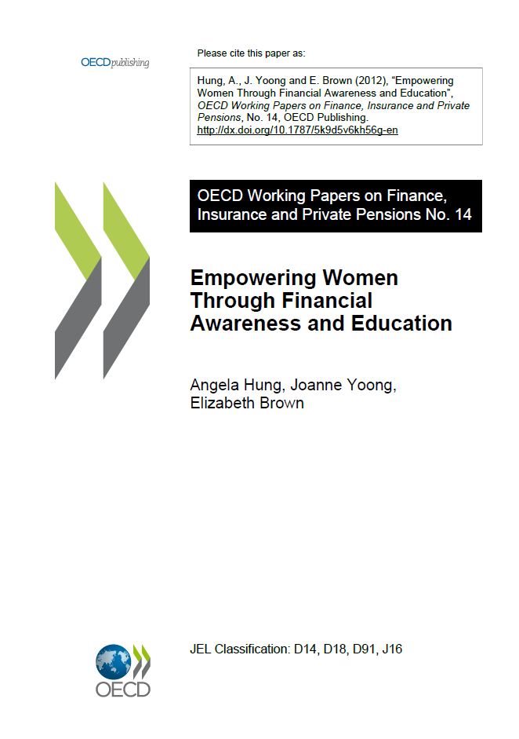
OECD INFE work
Creation of the OECD INFE Expert Subgroup “Empowering Women through Financial Education and Awareness” – chaired by India – 2010
  Scoping paper “Empowering Women through Financial Awareness and Education” (Hung et al., 2012)
  Report on evidence and case studies – to be released in 2013 (addressing G20 mandate)
  Preliminary policy guidance under development (addressing G20 mandate
… but clearly financial education is only part if the answer
  OECD Horizontal Project on Gender Equality in Education, Employment and Entrepreneurship
Notes:
Global relevance, but OECD INFE work started before

Slide 5
Outline
Gender differences in financial literacy and women’s vulnerabilities
Policy responses
Lessons and challenges

Slide 6
Gender differences in financial literacy and Women’s financial vulnerabilities

Slide 7
Women have lower financial knowledge
Large international evidence from many sources/countries Women have lower levels of financial knowledge
Albania, Armenia, Australia, Azerbaijan, British Virgin Islands, Bulgaria, Canada, Czech Republic, Estonia, Germany, India, Ireland,
Gender differences are not significant in
a minority of cases
East Germany, Hungary, and Russia
Italy, Jamaica, Japan, Malaysia, Netherlands, New Zealand, Norway, Peru, Poland, Portugal, South Africa, Sweden, UK, US
Notes:
Large international evidence that women have lower levels of financial knowledge: Albania, Armenia, Australia, Azerbaijan, British Virgin Islands, Bulgaria, Czech Republic, Estonia, Germany, India, Ireland, Italy, Jamaica, Japan, Malaysia, Netherlands, New Zealand, Norway, Peru, Poland, Portugal, Russian Federation, South Africa, Sweden, United Kingdom, United States
gender differences are not significant in Hungary, Russia and East Germany

Slide 8
Women’s financial attitudes
But some attitudes are likely to be conducive to more prudent behaviour
Some attitudes may hamper women’s ability to deal effectively with financial issues
Women have lower confidence than men in their financial knowledge and skills, especially with complex issues
Women and girls appear to be less interested in financial issues than men/boys
Women seem to be aware of their lack of financial knowledge
Men are more likely to be over-confident in their financial skills
Women are more risk-averse than men
Notes:
Some attitudes may hamper women’s ability to deal efficiently with financial issues:
Women have lower confidence than men in their financial knowledge and skills, especially with complex issue
Women less interested in financial issues
But some attitudes are likely to be conducive to more prudent behaviour:
Women appear to be aware of their lack of financial knowledge
Men are more likely to be over-confident in their financial skills
Women are more risk-averse than men

Slide 9
Some areas of financial behaviour are especially critical for women
Women appear to be better than men at short-term money management behaviour / having a budget
But can become vulnerable in other domains, as they are:
  Less able to save/ save smaller amounts (typically as a result of weaker labour market position)
  More likely to save informally (lower access to financial markets / lower financial inclusion)
  More likely to cut expenses, and less likely to earn extra money/work more when facing problems making ends meet
  Less likely to compare products across providers and to take informed decisions (i.e. by consulting either non-independent or independent sources of information)
Notes:
Women appear to be better than men at short-term money management behaviour: they are more likely than men to have a budget and to keep a close watch on their financial affairs.
Women are more likely to experience difficulties in making ends meet. In addition, women and men have different coping strategies for making ends meet. If confronted with situations where their income is not sufficient to cover living costs, women tend to cut expenses, while men prefer finding ways for earning extra money.
Problems with financial products choice - In some countries women are
Less likely to compare products across providers
Les likely to have made an attempt at taking an informed decision (i.e. by consulting either non-independent or independent sources of information)
Less likely to consult independent sources of information/ advice

Slide 10
Policy responses

Slide 11
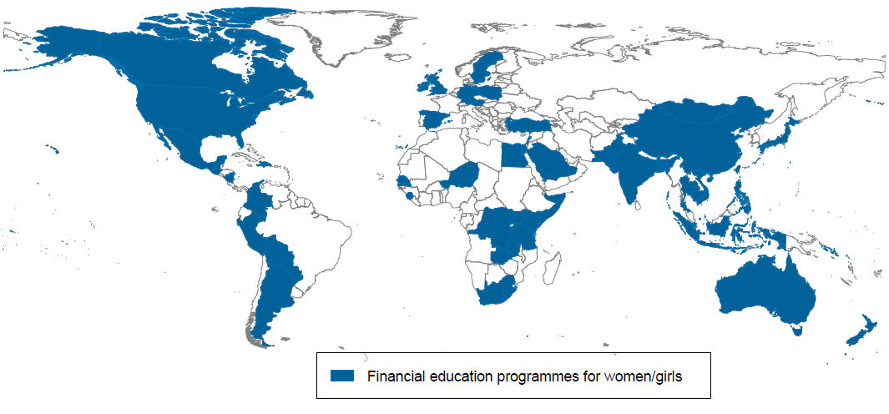
Growing awareness: programmes targeting women in many countries
This document and any map included herein are without prejudice to the status of or sovereignty over any territory, to the delimitation of international frontiers and boundaries and to the name of any territory, city or area.
Notes:
Over 50 countries : Argentina | Australia | Austria | Bangladesh | Bolivia, | Burundi | Cambodia | Canada | China | Colombia | Democratic Republic of Congo | Dominican Republic | Egypt | Germany | Guatemala | Haiti | India | Indonesia | Israel | Japan | Kenya | Lebanon | Malta | Mexico | Mongolia | New Zealand | Nicaragua | Niger | Pakistan | Palestine | Paraguay | Peru | Philippines | Poland | Samoa | Saudi Arabia | Senegal | Sierra Leone | Singapore | Solomon Islands | Somalia | South Africa | Spain | Sweden | Tanzania | Thailand | Turkey | Uganda | UK | US | Vietnam | Zambia

Slide 12
Programmes vary depending on countries’ circumstances and needs
Stakeholders (e.g. public authorities, local and international NGOs, MFIs, financial institutions)
Target groups (e.g. young/girls, elderly/widows, low-income/unemployed women, financially excluded, victims of violence)
Topics (e.g. financial products awareness and day-to-day financial management, borrowing, long-term financial planning, consumers’ rights)
Rural / urban settings
In combination with training on entrepreneurship / business skills, health-related issues, or with access to formal financial products

Slide 13
Addressing the needs of specific subgroups of women
Young / Elderly women
Financial education for middle-age and elderly women in Japan
Low income /marginalised
Financial education for illiterate or semi-literate women in rural areas of India
Female MSMEs
Various ILO projects in Cambodia
SEWA in India
GREAT Women project in the Philippines

Slide 14
Improving women’s financial strategies
In developing economies:
Increasing financial inclusion and improving the use of formal saving products; supporting female entrepreneurship
In more developed countries :
Supporting women in planning for retirement, avoiding over-indebtedness
e.g., providing girls with financial literacy training and access to savings account in Mongolia and Bangladesh
e.g., helping women approaching retirement to manage their finances better for financial independence in older years in Singapore

Slide 15
Lessons and Challenges

Slide 16
Common lessons from several case studies
While taking into account national circumstances and needs, some general lessons can be drawn
Broad approach: women’s financial empowerment and greater financial independence as a part of overall socio-economic empowerment. Valuable combination of FE with other types of training/interventions
Learning environment
  Learning in a group to share experiences and create sense of belonging
  Use of female trainers as role models to build confidence among trainees
Importance of starting in school

Slide 17
Challenges ahead...
Understanding the role of attitudes: women are aware of their lack knowledge and less over-confident → potentially more ‘teachable’
Finding ways to address social norms that may reduce women’s financial independence
Taking into account that women may be a particularly hard-to-reach group, due to social segregation, or lack of time due to work/social obligations
Tailoring content and delivery method to women’s lower expertise and preferences
Finding ways to provide relevant and unbiased advice to women
Obtaining more evidence on women’s needs through fin lit measurement surveys (including PISA assessment)
Analysing impact evaluation results by gender, even when a programme does not target women specifically

Slide 18
Next steps
OECD INFE Policy guidance on empowering women
through financial awareness and education– under development
OECD Recommendation on Gender Equality in Education, Employment and Entrepreneurship
Feed into Russian G20 Presidency agenda

Slide 19
THANK YOU!
Questions and feedback welcome!
Chiara.Monticone@oecd.org
OECD INFE www.financial–education.org
Russia/World Bank/OECD Financial Literacy and Education Trust Fund http://www.finlitedu.org/

