Slide 1
financial literacy in ASIA:
Some highlights of the OECD/INFE Survey on Financial Literacy and Financial Inclusion
Adele Atkinson,
Senior Policy Analyst, OECD

Slide 2
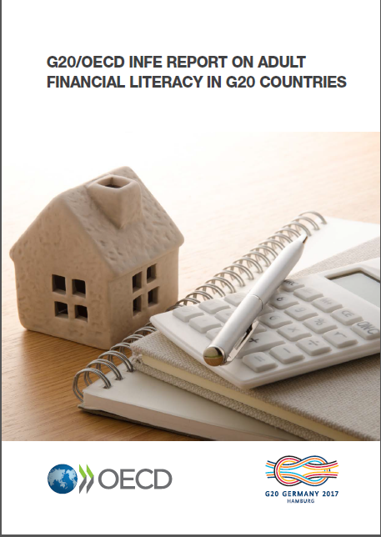
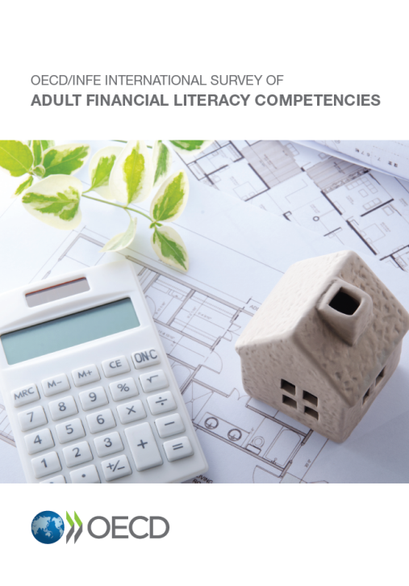
OECD/INFE survey to measure financial literacy and financial inclusion
Survey instrument to capture financial literacy…
…a combination of awareness, knowledge, skill, attitude and behaviour necessary to make sound financial decisions and ultimately achieve individual financial well-being
…in a representative sample of adults, and available in a Toolkit
Questionnaire (core) and additional (optional) questions
Methodological notes; Interviewer briefings
G20 Leaders welcomed and supported its use in 2013.
Updated in 2015.
Used to collect data and prepare two comparative reports in 2016/17.
Due to be revised again in 2018, for a possible comparative study in 2019.
Notes:
Core comp?

Slide 3
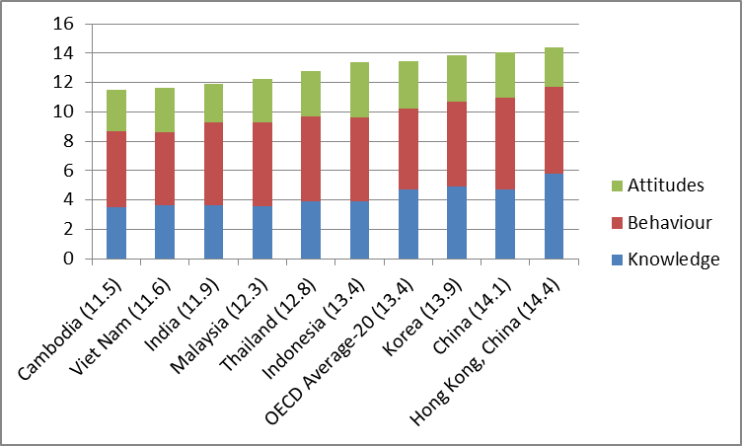
Financial literacy is a combination of knowledge, attitudes and beneficial financial behaviours
Sum of average financial knowledge, behaviour and attitudes scores
Source: OECD/INFE financial literacy and inclusion survey. The combined financial literacy score (sum of the three components) is reported in brackets next to the country name

Slide 4
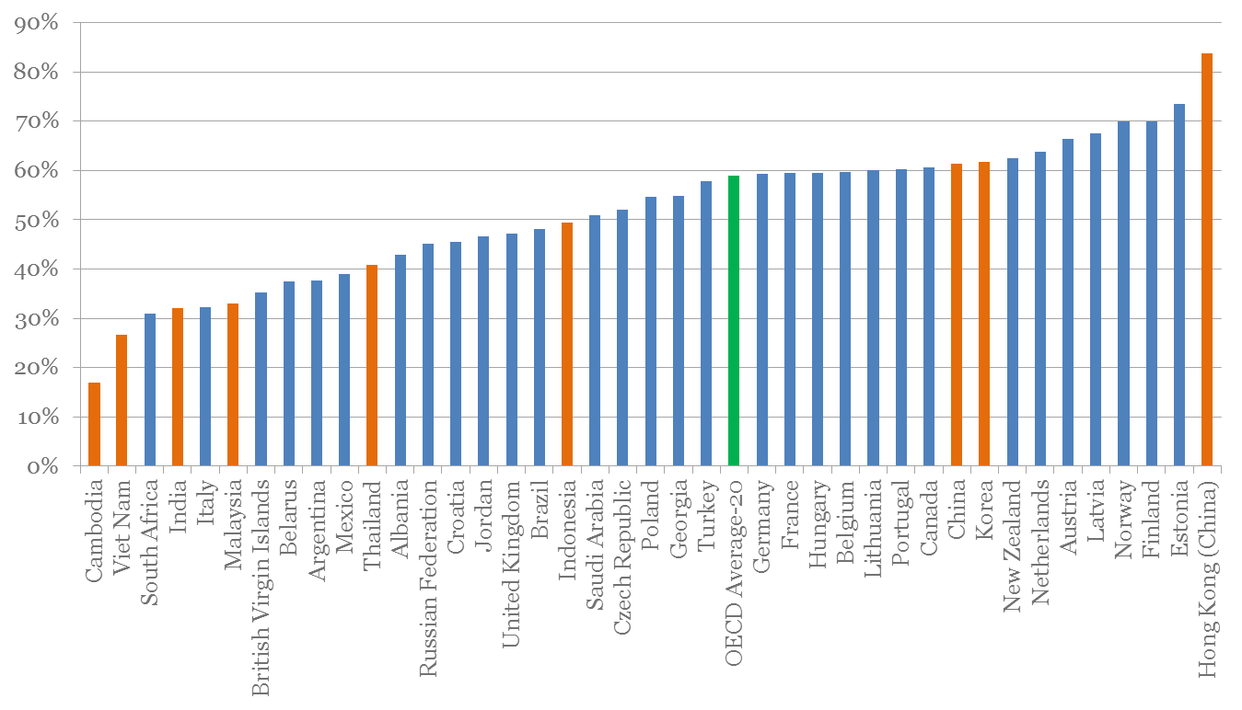
Percentage of adults who score at least 5 out of 7 on financial knowledge (minimum target score)
There is a very wide range of outcomes on financial knowledge across the Asian countries that submitted data
Source: OECD/INFE financial literacy and inclusion survey

Slide 5
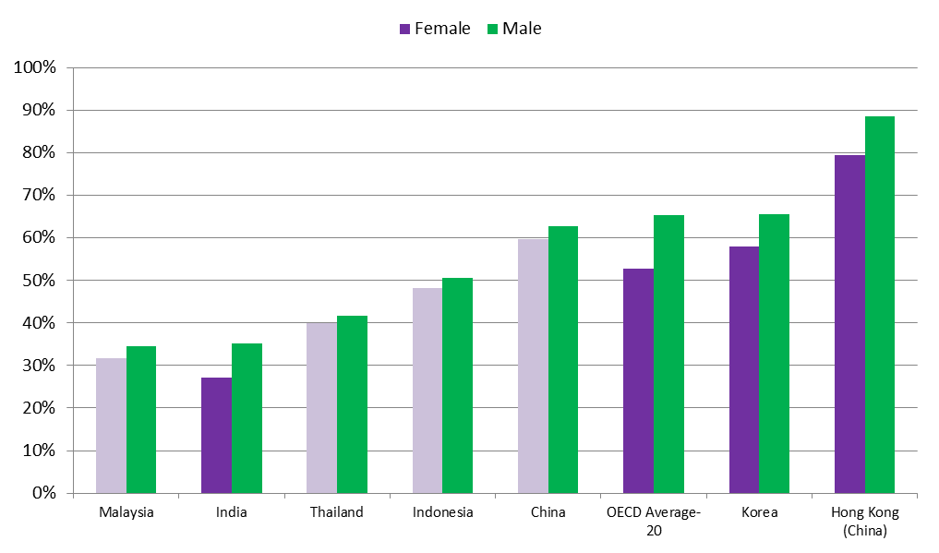
Percentage of male and female adults who score at least 5 out of 7 on financial knowledge
Men tend to have higher financial knowledge than women on average across OECD, but the difference is not significant in Malaysia, Thailand Indonesia and China
Source: OECD/INFE financial literacy and inclusion survey. Countries and economies where the gender difference is statistically significant at the 5% level are marked in a darker colour.

Slide 6
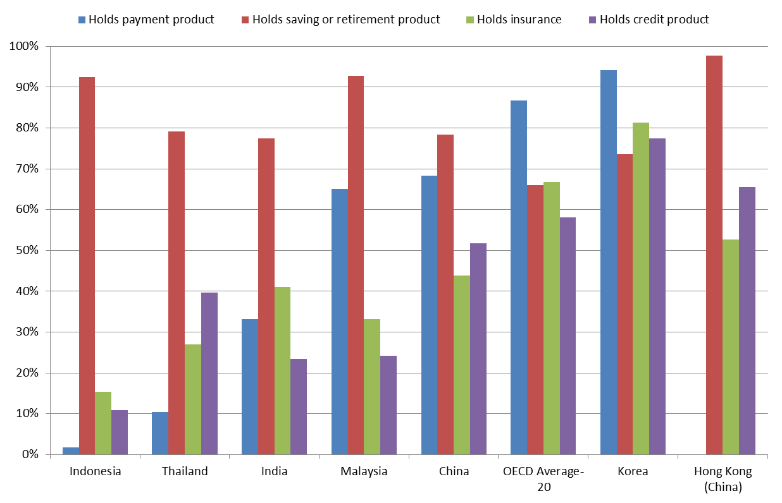
Savings products are more commonly held than payment products
Source: OECD/INFE financial literacy and inclusion survey

Slide 7
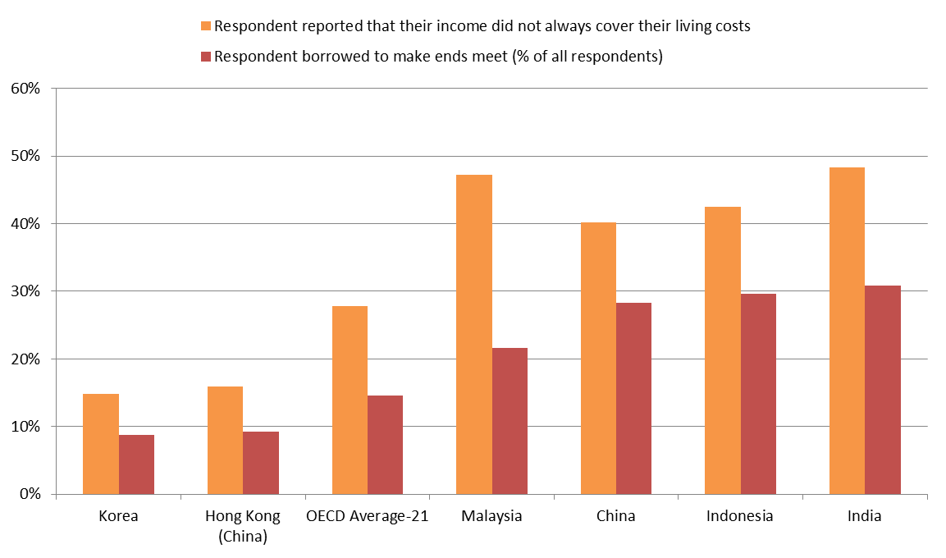
Many resort to credit when income falls short of living expenses
Source: OECD/INFE financial literacy and inclusion survey

Slide 8
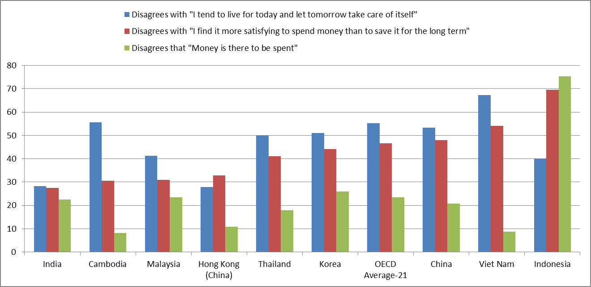
Attitudes towards saving, spending and living for the day
People in China, Viet Nam and Indonesia are more likely than OECD average to get satisfaction in saving, but attitudes vary widely to the main purpose of money and living for today. In India and Hong Kong, China, living for today is the norm

Slide 9
Conclusion
Countries across Asia face different challenges and priorities in terms of financial literacy
  Different outcomes by gender are not necessarily driven by a lack of knowledge
  In some countries large numbers of people are finding it hard to make ends meet and many borrow to make up the shortfall
  More policy makers in the region should consider measuring financial literacy to gain a better understanding of the levels of financial knowledge, attitudes and behaviour and the specific issues faced

