Slide 1
Supporting safe investment through financial education
Lyndwill Clarke
Head: Consumer Education
OECD/RBI
High-level Global Symposium
Implementing effective financial literacy policies in a changing financial landscape
9 November 2017,
DELHI, INDIA

Slide 2

Overview
OECD/INFE POLICY FRAMEWORK FOR INVESTOR EDUCATION
An Enabling Framework
Delivering Investor Education

Slide 3
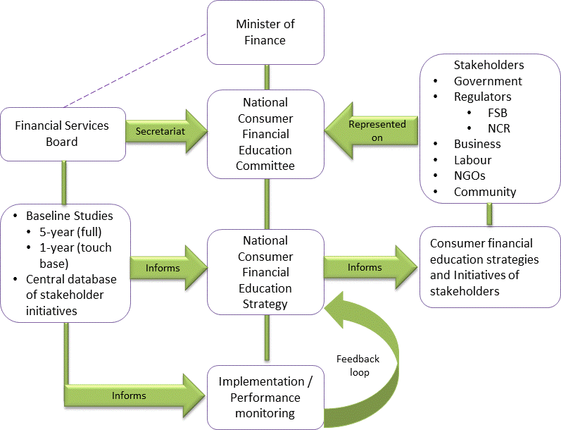
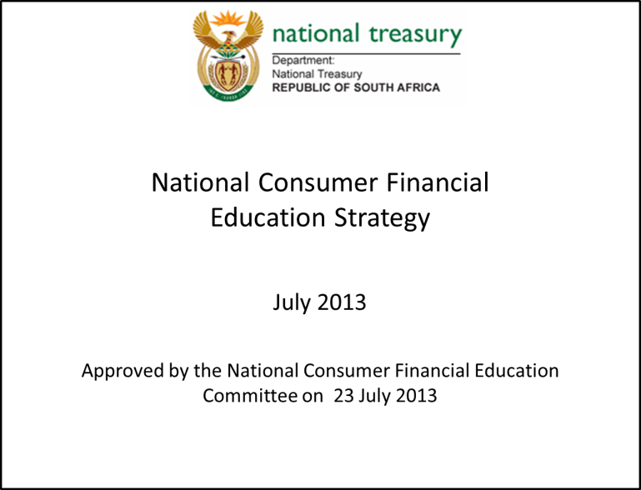
Enabling Environment
FSB Act No. 97 of 1990, as amended in 2000 and in
Financial Services Laws General Amendments Act, 2013
“provide, promote or otherwise support financial
education, awareness and confidence regarding
financial products, institutions and services.’’
FINANCIAL LITERACY LEVELS
Domain | 2011 | 2012 | 2013 | 2015 | Trend
Financial control | 58 | 61 | 61 | 63 | Increased
Financial planning | 53 | 50 | 48 | 48 | Decreased
Product choice | 45 | 46 | 44 | 46 | Stable
Financial knowledge | 56 | 55 | 56 | 58 | Stable
Overall financial literacy | 54 | 54 | 52 | 55 | Stable

Slide 4
Enabling Environment
Financial Sector Regulatory Act , 2017
Action | Outcomes
Created comprehensive and rigorous market conduct reporting and supervision requirements | ensure that consumers of financial products and financial services are not vulnerable and exploited ensure that the efficiency and integrity of financial markets is protected and enhanced, contribute to the maintenance of financial stability, promote financial inclusion, and assist in combating financial crime.
Introducing measures for identification, detection and reporting of unfair treatment to customers
Responsibly create financial awareness around financial services and available financial products
Increase and improve financial literacy levels of consumers and potential consumers through comprehensive and effective financial education programmes
MARKET CONDUCT
PRUDENTIAL
FINANCIAL STABILITY
Conduct of Business
Banking
Market Integrity
Insurance
Financial
Market Infrastructure
Consumer Education
Financial Conglomerates
Resolution Authority
FSCA
P A
SARB
Objectives of the FSCA
57. The objective of the Financial Sector Conduct Authority is to—
(a) enhance and support the efficiency and integrity of financial markets; and
(b) protect financial customers by—
(i) promoting fair treatment of financial customers by financial institutions; and
(ii) providing financial customers and potential financial customers with financial education pro-grams, and otherwise promoting financial literacy and the ability of financial customers and potential financial customers to make sound financial decisions; and
(c) assist in maintaining financial stability.

Slide 5
Enabling Environment
Population | 55.6m
Unemployment rate (Jan 2017) | 26.5%
Youth (15 -34) | 36.2%
Youth unemployment (Jan 2017 | 50.9%
Statistics South Arica
24.25m credit active South Africans
59.4% in good standing
National Credit Regulator
Lack of suitable products
Complexity of investment products and investing processes
Notes:
Creating an enabling environment might be good but socia-economic circumstances might create barriers to Investing:
Overall policy, market and welfare context.
Debt levels
Long term investment strategies
Poverty
Lack of suitable products
Informal savings clubs chosen over regulated investments
Stuff that cant fit on the slide:
Financial literacy levels
Consumer confidence
Fintech
Personal Economic situation
Complex financial products
Consumer vs Industry change

Slide 6

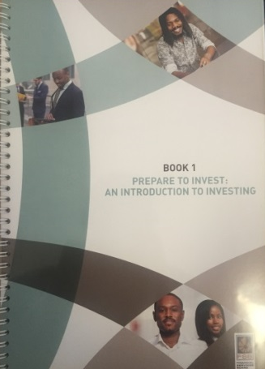
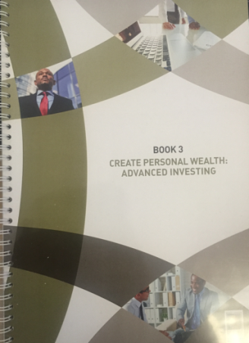

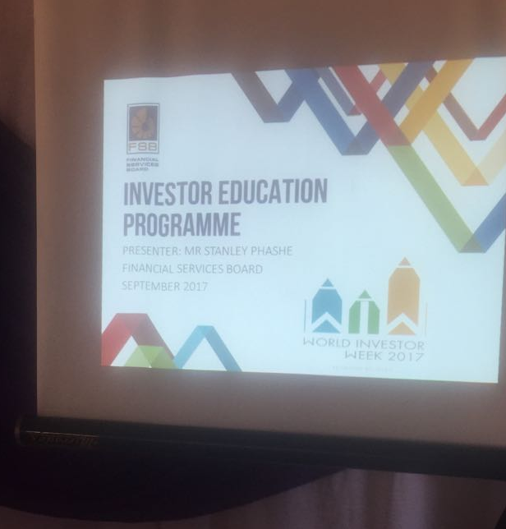
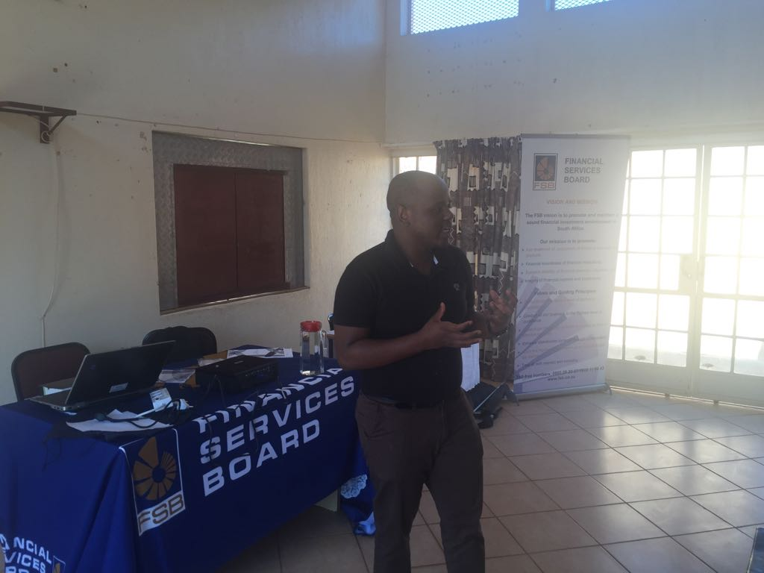
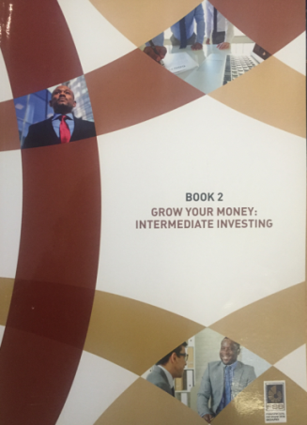

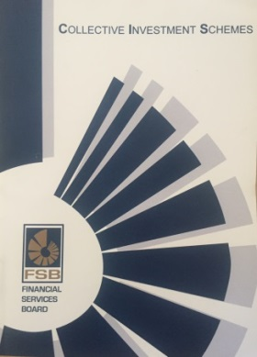
Delivering Investor Education
Content development
Part of personal financial management
Appropriate language

Slide 7
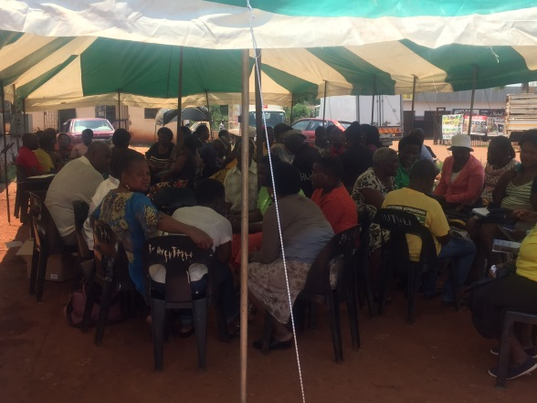
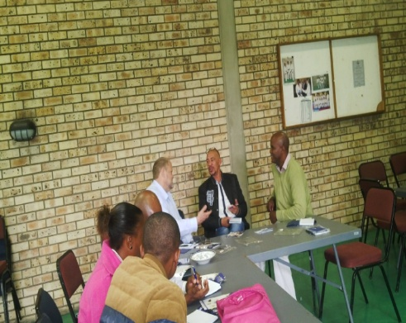
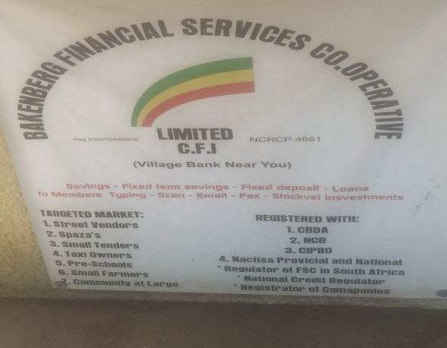
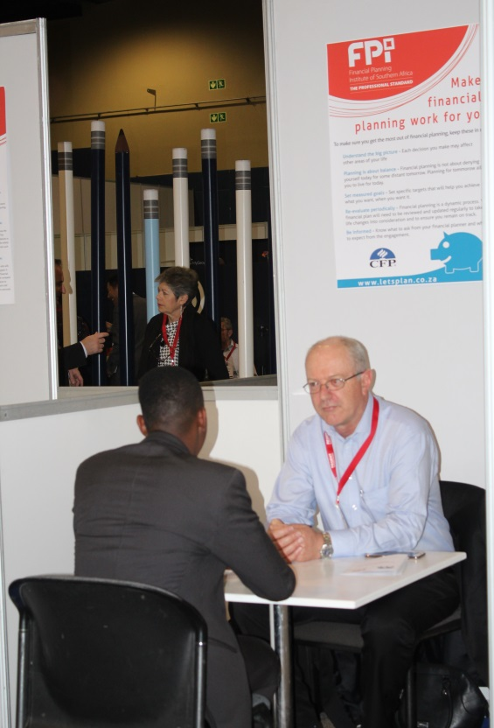
Delivering Investor Education
Emerging entrepreneurs (Urban)
7 workshops
reaching 213 emerging entrepreneurs
Investment products + pyramid and ponzi schemes
Financial Planning Institute (Advice)
2 hour workshops
  Budgeting, debt, savings and investment
Quarterly newsletter
Financial Planning day/week
  One-on-one pro-bono sessions
  Specific advice (life stage)
Cooperative banks (Rural)
financial management
investment products: bonds, CIS and shares,
24 workshops
reached 500 members

Slide 8


Delivering Investor Education
‘Ghost’ trading platform
Who can participate?
Enhance financial literacy of SA youth
Enhance SA youth’s understanding of securities market and its role
Equip SA youth with financial & entrepreneurial skills
Schools
Grade 8-12, must be 4 members and a registration fee of R120.
Universities
Ages between 18+ , 2-4 members in a team and a registration fee of R150.
JSE Investment Challenge
Investment Challenge Stats
Year | Institutions |  | Teams |  | Participants
 | SCHOOL | UNIVERSITY | SCHOOL | UNIVERSITY | SCHOOL | UNIVERSITY
2015 | 405 | 74 | 2472 | 1006 | 9742 | 2776
2016 | 409 | 41 | 3002 | 1075 | 11 773 | 3021
2017 | 483 | 57 | 3986 | 1192 | 15 381 | 3198
Income
Equity
Speculator
Low volatility
Medium volatility
High volatility

Slide 9



Thank you for your attention
Contact details:
Mr Lyndwill Clarke
HOD: Consumer Education
Financial Services Board –
South Africa
E-mail: Lyndwill.Clarke@fsb.co.za Tel: (+27) 12 422 2819
Mobile: (+27) 79 881 1805
www.fsb.co.za

Slide 10
Thank You

